Slide 1

Learn. Imagine. Build. .NET Conf
Going Serverless with Azure Functions and C#
Cecil Phillip
@cecilphillip

Slide 2
The evolution of application platforms
On-Premises
IaaS
PaaS
Serverless

Slide 3
Before cloud
What is the right size of
servers for my business needs?
What happens in case of
server hardware failure?
How do I deploy new code to my server?
Which packages should
be on my server?
How can I increase server utilization?
What media should I
use to keep backup?
How can I scale my app?
What size of servers
should I buy?
Who monitors
my App?
How often should I backup my server?
Who monitors
my Servers?
What storage I need to use?
Which OS should I use?
Who has physical
access to my servers?
Are my server in a
secure location?
Do I need secondary
network connection?
How many servers
do I need?
Do I need a UPS?
What happens if the
power goes out?
How often should
I patch my servers?
How can I dynamically
configure my app?
It takes how long to provision a new server?

Slide 4
Then came IaaS—table stakes for digital business
What is the right size of servers for my business needs?
How can I increase server utilization?
How many servers do I need?
How can I scale my app?
How often should I patch my servers?
How do I deploy new code to my server?
How often should I backup my server?
Which OS should I use?
Which packages should be on my server?
Who monitors my App?

Slide 5
Then PaaS, critical for digital transformation
What is the right size of “servers” for my business needs?
How can I increase “server” utilization?
How many “servers” do I need?
How can I scale my app?

Slide 6
What is Serverless?
$
Abstraction of servers
Event-driven
Micro-billing

Slide 7
Benefits of Serverless
Automatically Scale
Focus on business logic
Faster time to market

Slide 8



Serverless Components in Azure
Functions
Logic Apps
Event Grid
Serverless Compute
Serverless Workflow
Serverless Events

Slide 9


Introducing Azure Functions
Code
Azure Functions
Events + data
Notes:
Azure Stack
Open source

Slide 10
Triggers and Bindings
Type | Service | Trigger | Input | Output
Schedule | Azure Functions | ü
HTTP | Azure Functions | ü |  | ü
Blob Storage | Azure Storage | ü | ü | ü
Events | Azure Event Hubs | ü |  | ü
Queues | Azure Storage | ü |  | ü
Queues and topics | Azure Service Bus | ü |  | ü
Storage tables | Azure Storage |  | ü | ü
No-SQL DB | Azure CosmosDB |  | ü | ü
Push notifications | Azure Notification Hubs |  |  | ü
Twilio SMS Text | Twilio |  |  | ü
SendGrid email | SendGrid |  |  | ü

Slide 11
Automatically referenced packages
These assemblies are automatically referenced:
mscorlib
System
System.Core
System.Xml
System.Net.Http
Microsoft.Azure.WebJobs
Microsoft.Azure.WebJobs.Host
Microsoft.Azure.WebJobs.Extensions
System.Web.Http
System.Net.Http.Formatting
Platform packages, use #r directly
Newtonsoft.Json
Microsoft.WindowsAzure.Storage
Microsoft.ServiceBus
Microsoft.AspNet.WebHooks.Receivers
Microsoft.AspNet.WebHooks.Common
Microsoft.Azure.NotificationHubs

Slide 12
Demo:
Azure Functions Portal

Slide 13
New Visual Studio 2017 tooling
Based on .NET class libraries
Get the full power of IntelliSense, unit testing, and local debugging
Use attributes to define triggers and bindings

Slide 14
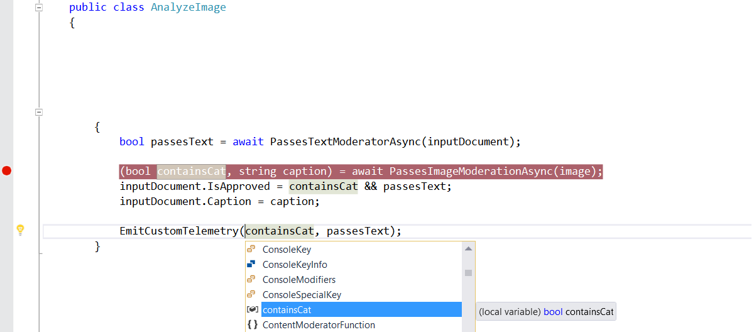
Visual Studio 2017 Tooling
/// Function entry point. Review image and text and set inputDocument.isApproved.
[FunctionName("ReviewImageAndText")]
public static async Task ReviewImageAndText(
[QueueTrigger("%queue-name%")] ReviewRequestItem queueInput,
[Blob("input-images/{BlobName}", FileAccess.Read)] Stream image,
[DocumentDB("customerReviewData", "reviews", Id = "{DocumentId}")] dynamic inputDocument)

Slide 15
Demo:
Developing Locally

Slide 16
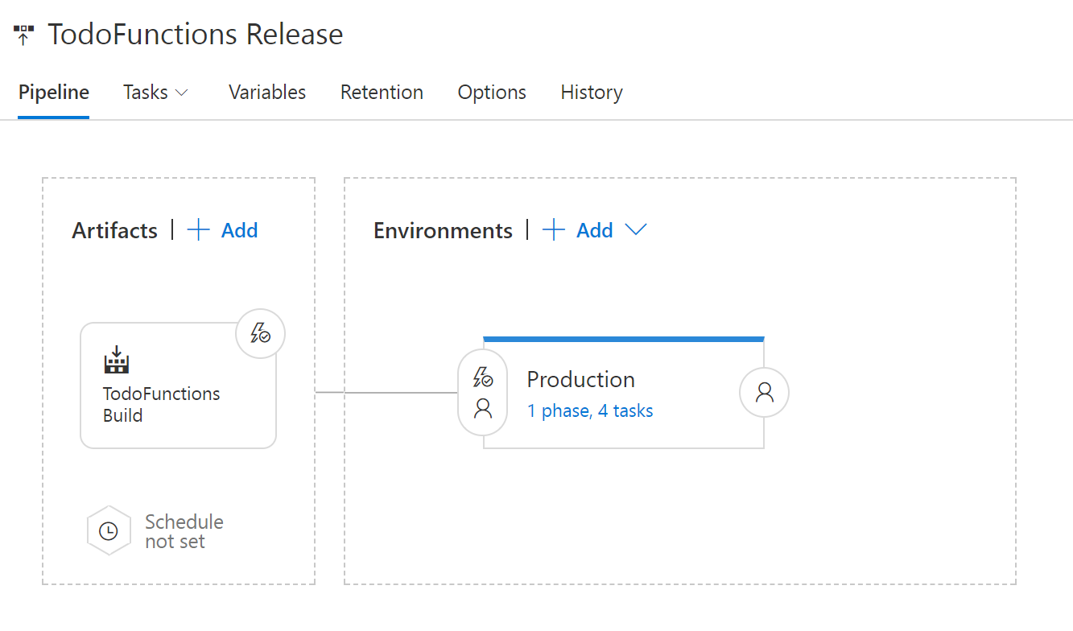
VSTS
Build and deploy with VSTS

Slide 17
Application Insights
Integrated monitoring and custom metrics with Application Insights
Write custom queries using the analytics portal
Pin graphs to portal dashboard
Notes:
Integrated Tracing
Custom metrics
App Insights NuGet Package

Slide 18
Demo:
Build & Deploy

Slide 19
Resources
Microsoft Docs – https://docs.microsoft.com
Azure Functions – https://functions.azure.com
GitHub Repo – https://aka.ms/func-github
Twitter - @AzureFunctions
Notes:
Mention Azure functions YouTube
StackOverflow
Functions is open sournce

Slide 20
Questions ?

